Slide 1
Procedural Content Generation
An overview and small guide

Slide 2
What is PCG?
Procedural Content Generation
Use algorithms to generate content
This saves time* and memory.
*This is debatable as the generation of PCG algorithms can take some time.

Slide 3
Command Design Pattern
Remember we discussed storing the inputs for a replay and re-running the whole thing under computer control?
Same idea.
Rather than store content, assets etc., just store the code.

Slide 4
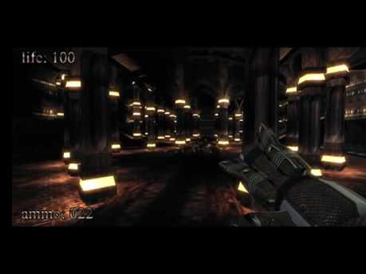
.kkrieger is a game that takes up 96k of memory

Slide 5
Examples
Speedtree
https://www.pouet.net/prod.php?which=78044
Procedural Content Generation Wiki
What an amazing modern world we live in.

Slide 6
Teleogical vs. Ontogenetic
Create an accurate physical model
Fluid Dynamics
Dynamic Weather
Fire propagation
Genetic Algorithms
Mimic a natural phenomenon without taking all the steps in-between.
Maze Generation
Tree and Foliage
Perlin Noise
L-Systems

Slide 7
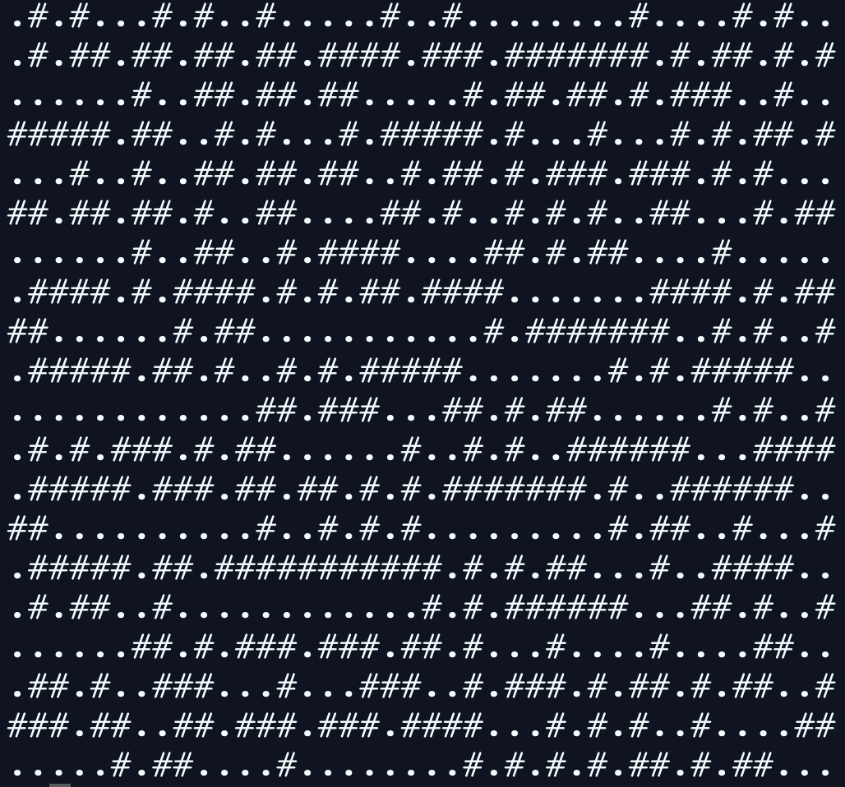
Mazes (also dungeons and cities)
Maze Gen using Growing Tree
Let C be a list of cells, initially empty. Add one cell to C, at random.
Choose a cell from C, and carve a passage to any unvisited neighbor of that cell, adding that neighbor to C as well. If there are no unvisited neighbors, remove the cell from C.
Repeat #2 until C is empty.

Slide 8

Growing Tree Algorithm: Choices
the right algorithm in the wrong place… makes all the difference in the world
Choose a cell from C, and carve a passage to any unvisited neighbor of that cell, adding that neighbor to C as well. […]
If we take the most recent cell, we get the recursive backtracking algorithm, If we always pick at random, we get Prim’s algorithm.

Slide 9
Things we can do with mazes
Suppose each time we select a cell there is a random chance that we:
Place a building
Place a room (which is really a building without walls)
If we are on an edge randomly add a new cell
or block of cells
Add another dimension.
I.e. allow the algorithm to go up and down as well as NEWS

Slide 10
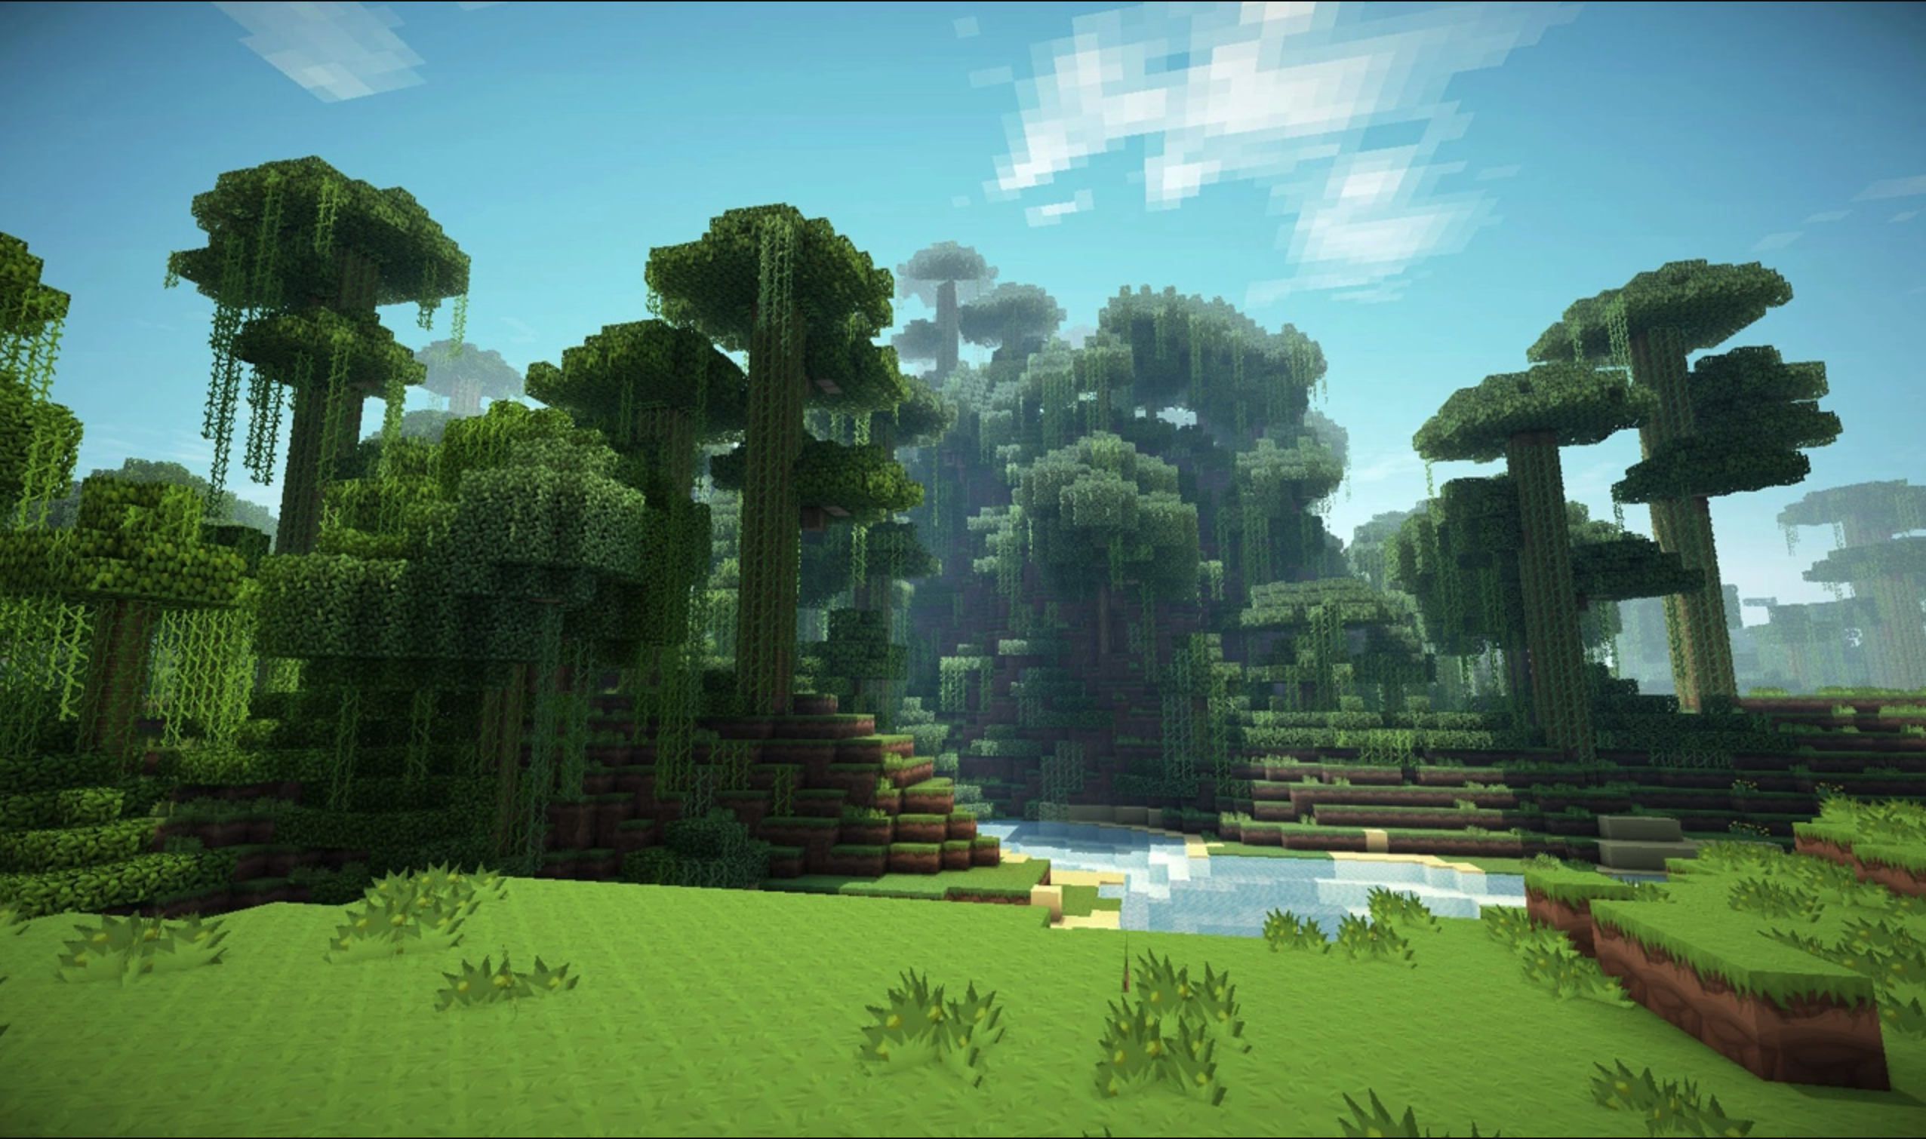
Things we can't do with mazes
Generating a maze is pretty simple. Generating a 3D space is something else.
For one if we just randomly select things, we get a bunch of discrete values that don't look very good.

Slide 11



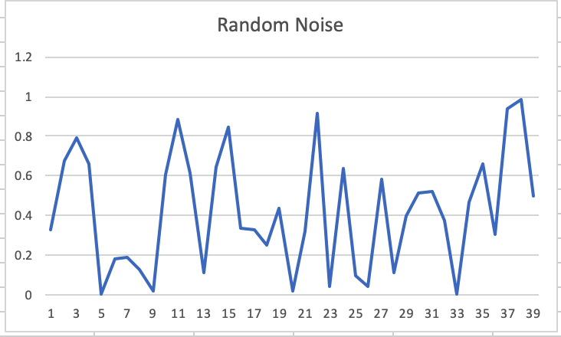
The A problem with random numbers
Random numbers are great.
The issue though is that doesn’t look like a mountain range.

Slide 12
Perlin Noise
Ken Perlin came up with this idea when working on Tron (1982)
He would later come up with a faster version known as Simplex noise.
The idea is to use dot products to smooth the transition between points.

Slide 13
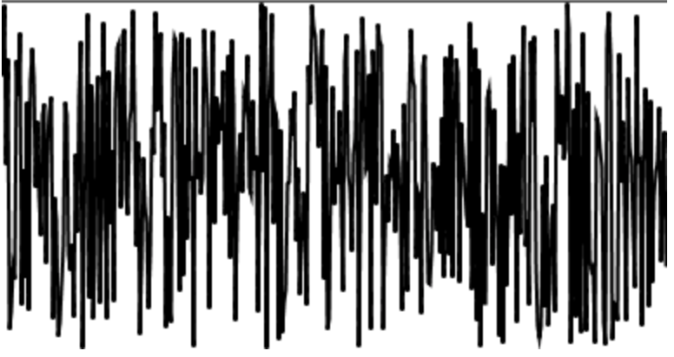
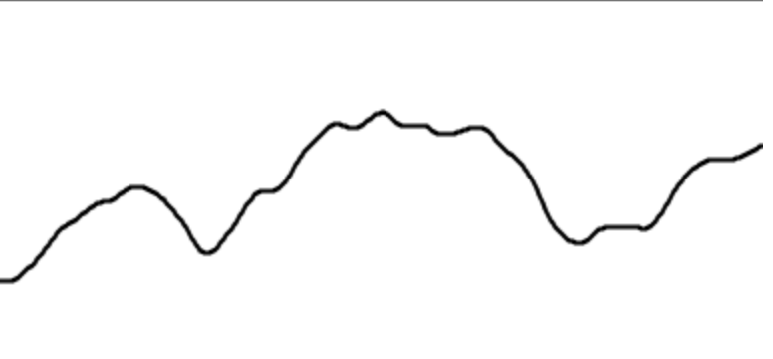
Essentially
We go from this
To this

Slide 14
1D 2D 3D
Applying the idea of noise to a terrain can allow us to create realistic height mapping.
Basically we don't have a 1k peak right next to a 2k valley.
We randomly add height values to a grid.
Then we use our noise function to smooth the transition between points.
x | z | y
-3 | 3 | 0.48832227
-3 | 5 | 0.29381454
-2 | 0 | 0.11765566
4 | 5 | 0.30102511
0 | 0 | 0.62785247

Slide 15
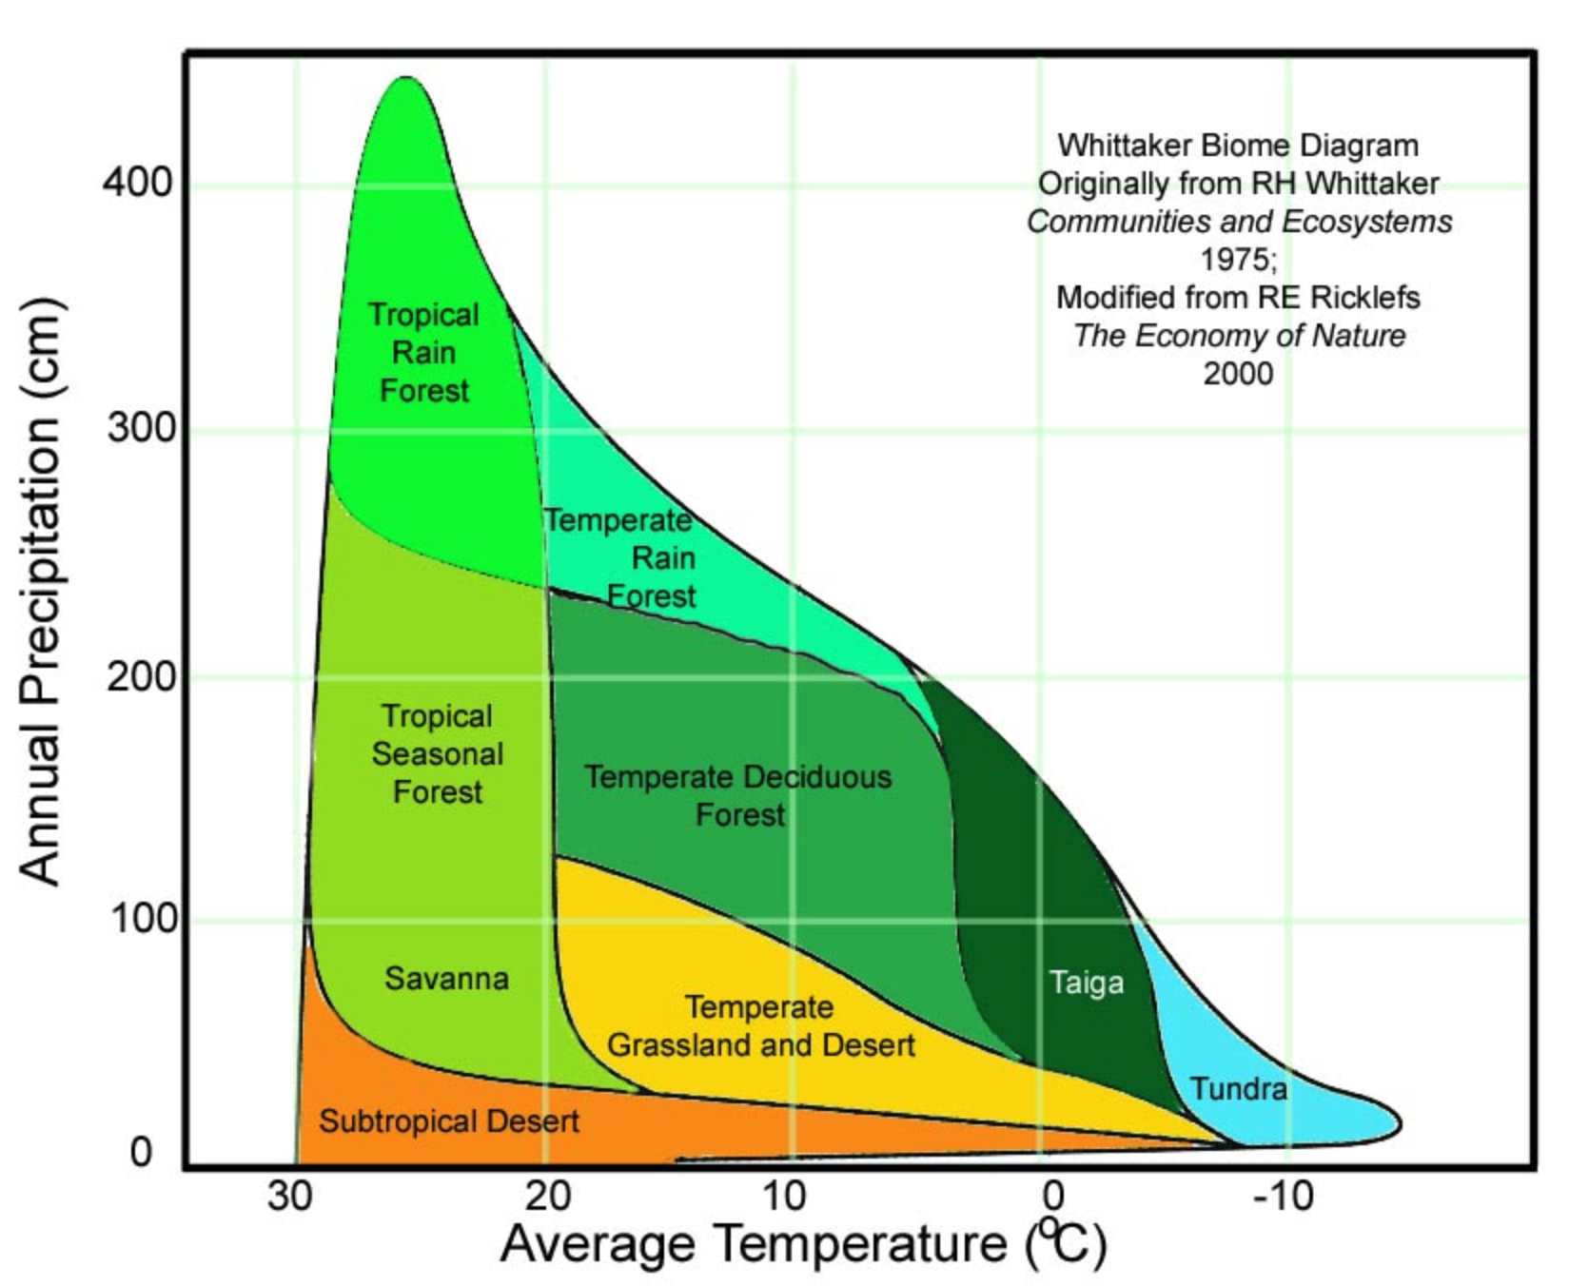
Rank Abundance Curve AKA Whittaker Plot
Now we use the data from our height mapping and generate a mapping of height and average temperature…
Also use more perlin noise to generate rainfall…
http://pcg.wikidot.com/pcg-games:minecraft

Slide 16
Minecraft!
This is essentially how Mojang came up with the biomes in Minecraft.

Slide 17
Perlin Resources
Generating archipelagos with Perlin noise (if you read none of the others read this one)
Perlin noise in C++11
The math behind perlin
Noise library in C++

Slide 18
Markov Chains
One of my favorite topics

Slide 19
Markov Chains
Create a dictionary of terms.
{'a','b','n','n','a','a'}
Randomly pick one.
n
Repeat
nnaaaaa…
This is stupid.
Make a better set:
Banana
{'a':['n',n,' '],b':['a'],'n':['a','a', 'a']}
Randomly select…
python example (that may break repl.it)
Notes:
If we instead record the letters that follow each other we can then generate random text that doesn't appear to be completely random (i.e. gibberish)

Slide 20
Markov More than Text
List of stats?
List of METHODS
Use something like strategy to apply different abilities. i.e. wallcrawl can be followed by…
Generate random gear
If Maliwan is returned 75% chance of adding random elemental + pick random grip…
If Jakobs: pick from high damage + pick random barrel…

Slide 21

Markov Platforms
?
?
Notes:
If we create a method that will generate platforms, A B and C. Then with some application of logic we can say that Platform A is always followed by A or B. Likewise Platform B is always followed by B, A or C. Platform C is Followed by D or B. D is followed by A

Slide 22
If we label our platforms…
D
C
?
?
B
A
A
Notes:
If we create a method that will generate platforms, A B and C. Then with some application of logic we can say that Platform A is always followed by A or B. Likewise Platform B is always followed by B, A or C. Platform C is Followed by D or B. D is followed by A

Slide 23
We have created a system
Our variables are A, B, C and D.
Our Starting point is A, B, or C
Our rules are: A → [A || B ] B → [ A || C ] C → [ B || C || D ] D → [ A ]
With some fairly simple code, something like: genPlatforms(12); genEnding();
We have a level
Different levels will have different platform counts and 'difficulties'

Slide 24
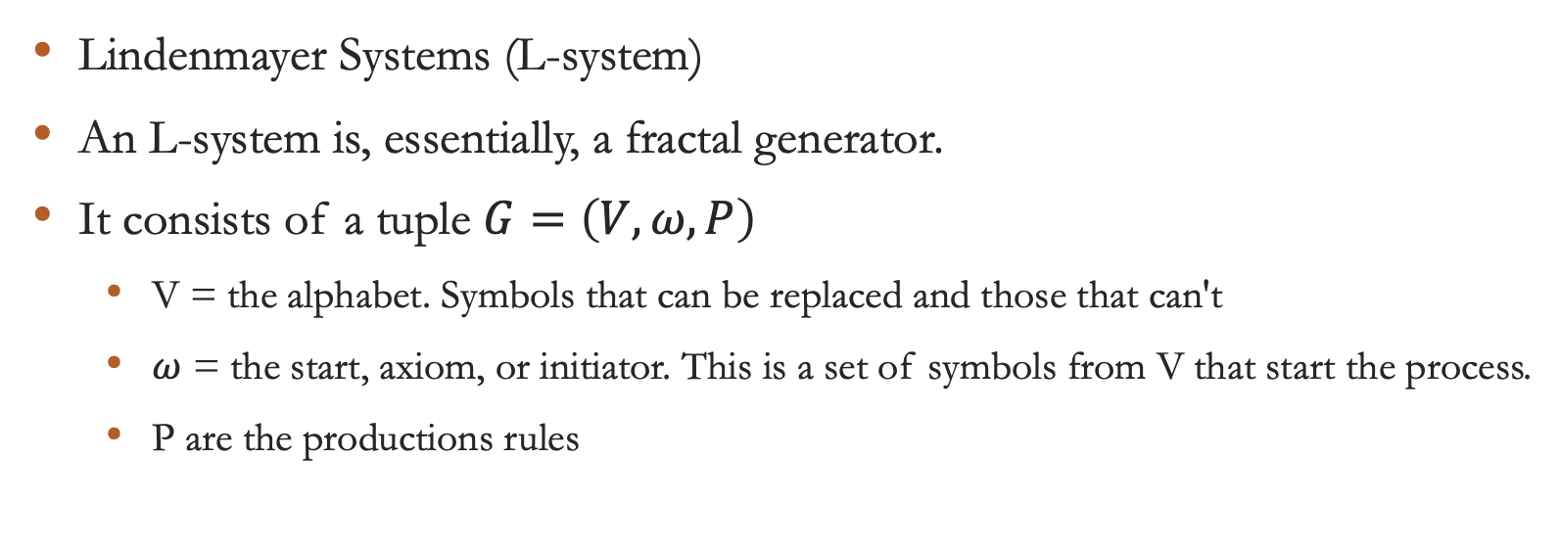
L-Systems
Lindenmayer Systems (L-system)
An L-system is, essentially, a fractal generator.
It consists of a tuple $G=\left(V,ω,P\right)$
V = the alphabet. Symbols that can be replaced and those that can't
$ω$ = the start, axiom, or initiator. This is a set of symbols from V that start the process.
P are the productions rules

Slide 25
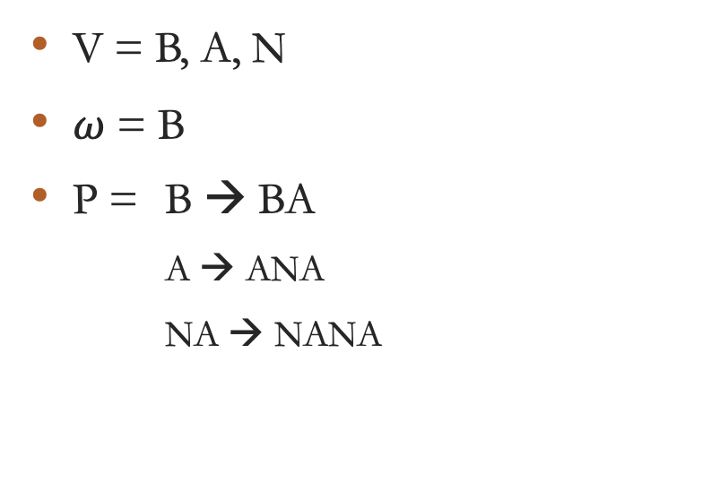

$$G=\left(V,ω,P\right)$$
V = B, A, N
$ω$ = B
P = B → BA
A → ANA
NA → NANA
B → BA
BA → BANA
BANA → BANANA
…
BANANA → BANNANA
BANNNANA

Slide 26
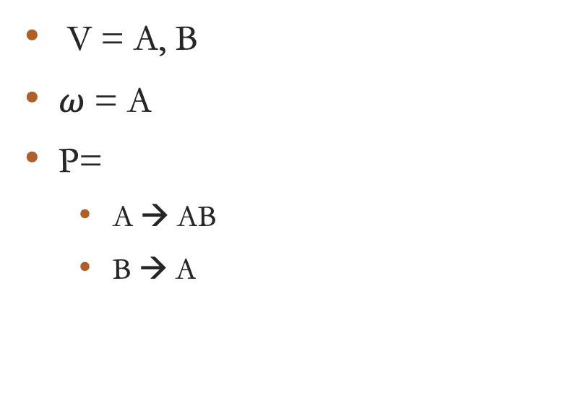
Original L-System: Algae
V = A, B
$ω$ = A
P=
A → AB
B → A
n = 0 : A n = 1 : AB n = 2 : A B A n = 3 : AB A AB n = 4 : n = 7 : ABAABABAABAABABAABABAABAABABAABAAB

Slide 27
Trees, Foliage, Beaches
L-systems work really well for simulating naturally occurring things.
It's almost as though using fractals to imitate fractals works well.
https://store.speedtree.com/

Slide 28
Notes:
L-System trees are generally very realistic.

Slide 29
Thought Problem
How would you use a dynamic process, similar to what we discussed, to generate a river?
How about a city?
Nice write up of a procedural city
Source code
How about a tree?

Slide 30
More Examples
Borderlands PCG ‘cel’ shading
https://www.youtube.com/watch?v=-cw2gXq83n8
SCI Gen a scientific research paper generator
Speedtree
2D Autotiling
Fisher Yates Shuffle

